Slide 1


The Leadership of the Asian Olympic Movement and The Asian Games History
1913–1934
FAR EASTERN CHAMPIONSHIP GAMES
1934–1938
FIRST WEST ASIAN GAMES
1951- ……
ASIAN GAMES

Slide 2

ASIAN GAMES HISTORY
FAR EASTERN CHAMPIONSHIP GAMES ( 1913-1934)

Slide 3

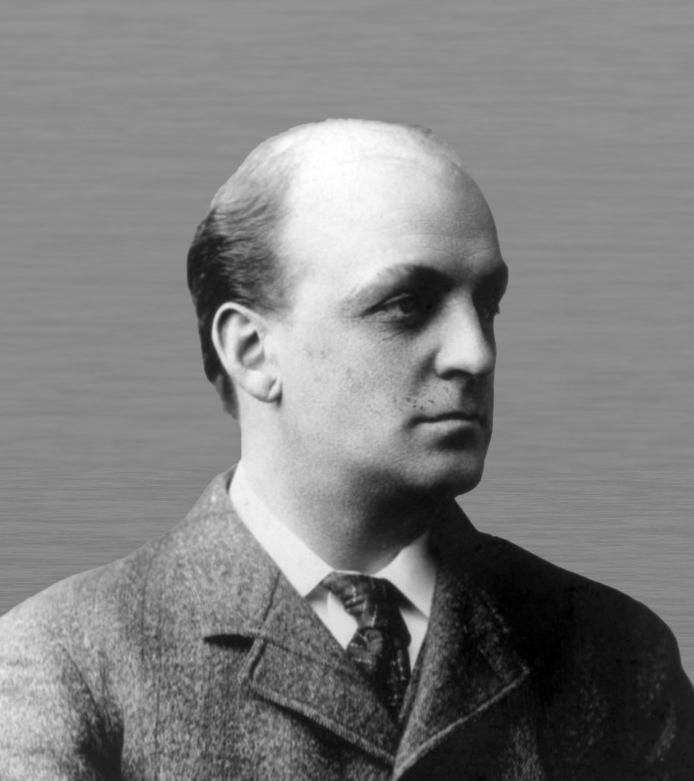
PRESIDENT: WILLIAM CAMERON FORBES
1913 Manila (Philippines)
1st Far Eastern Championship Games

Slide 4

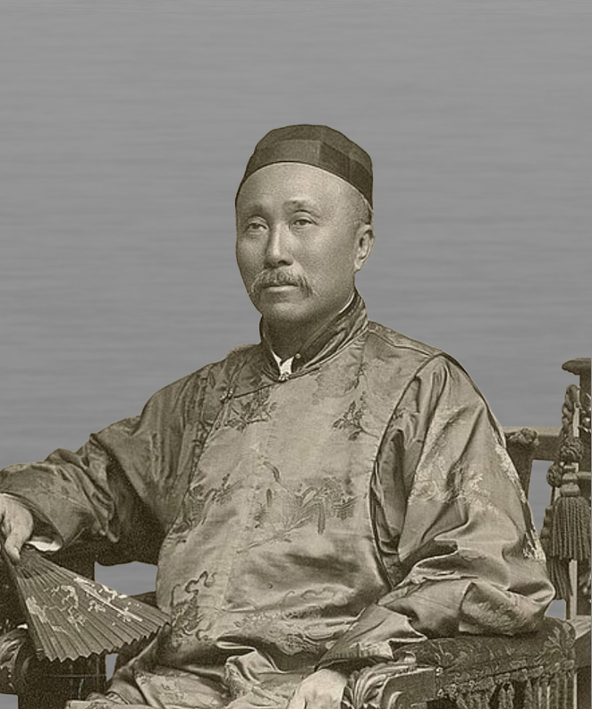
PRESIDENT: DR. WU TINGFANG
1915 Shanghai (People’s Republic of China)
2nd Far Eastern Championship Games

Slide 5

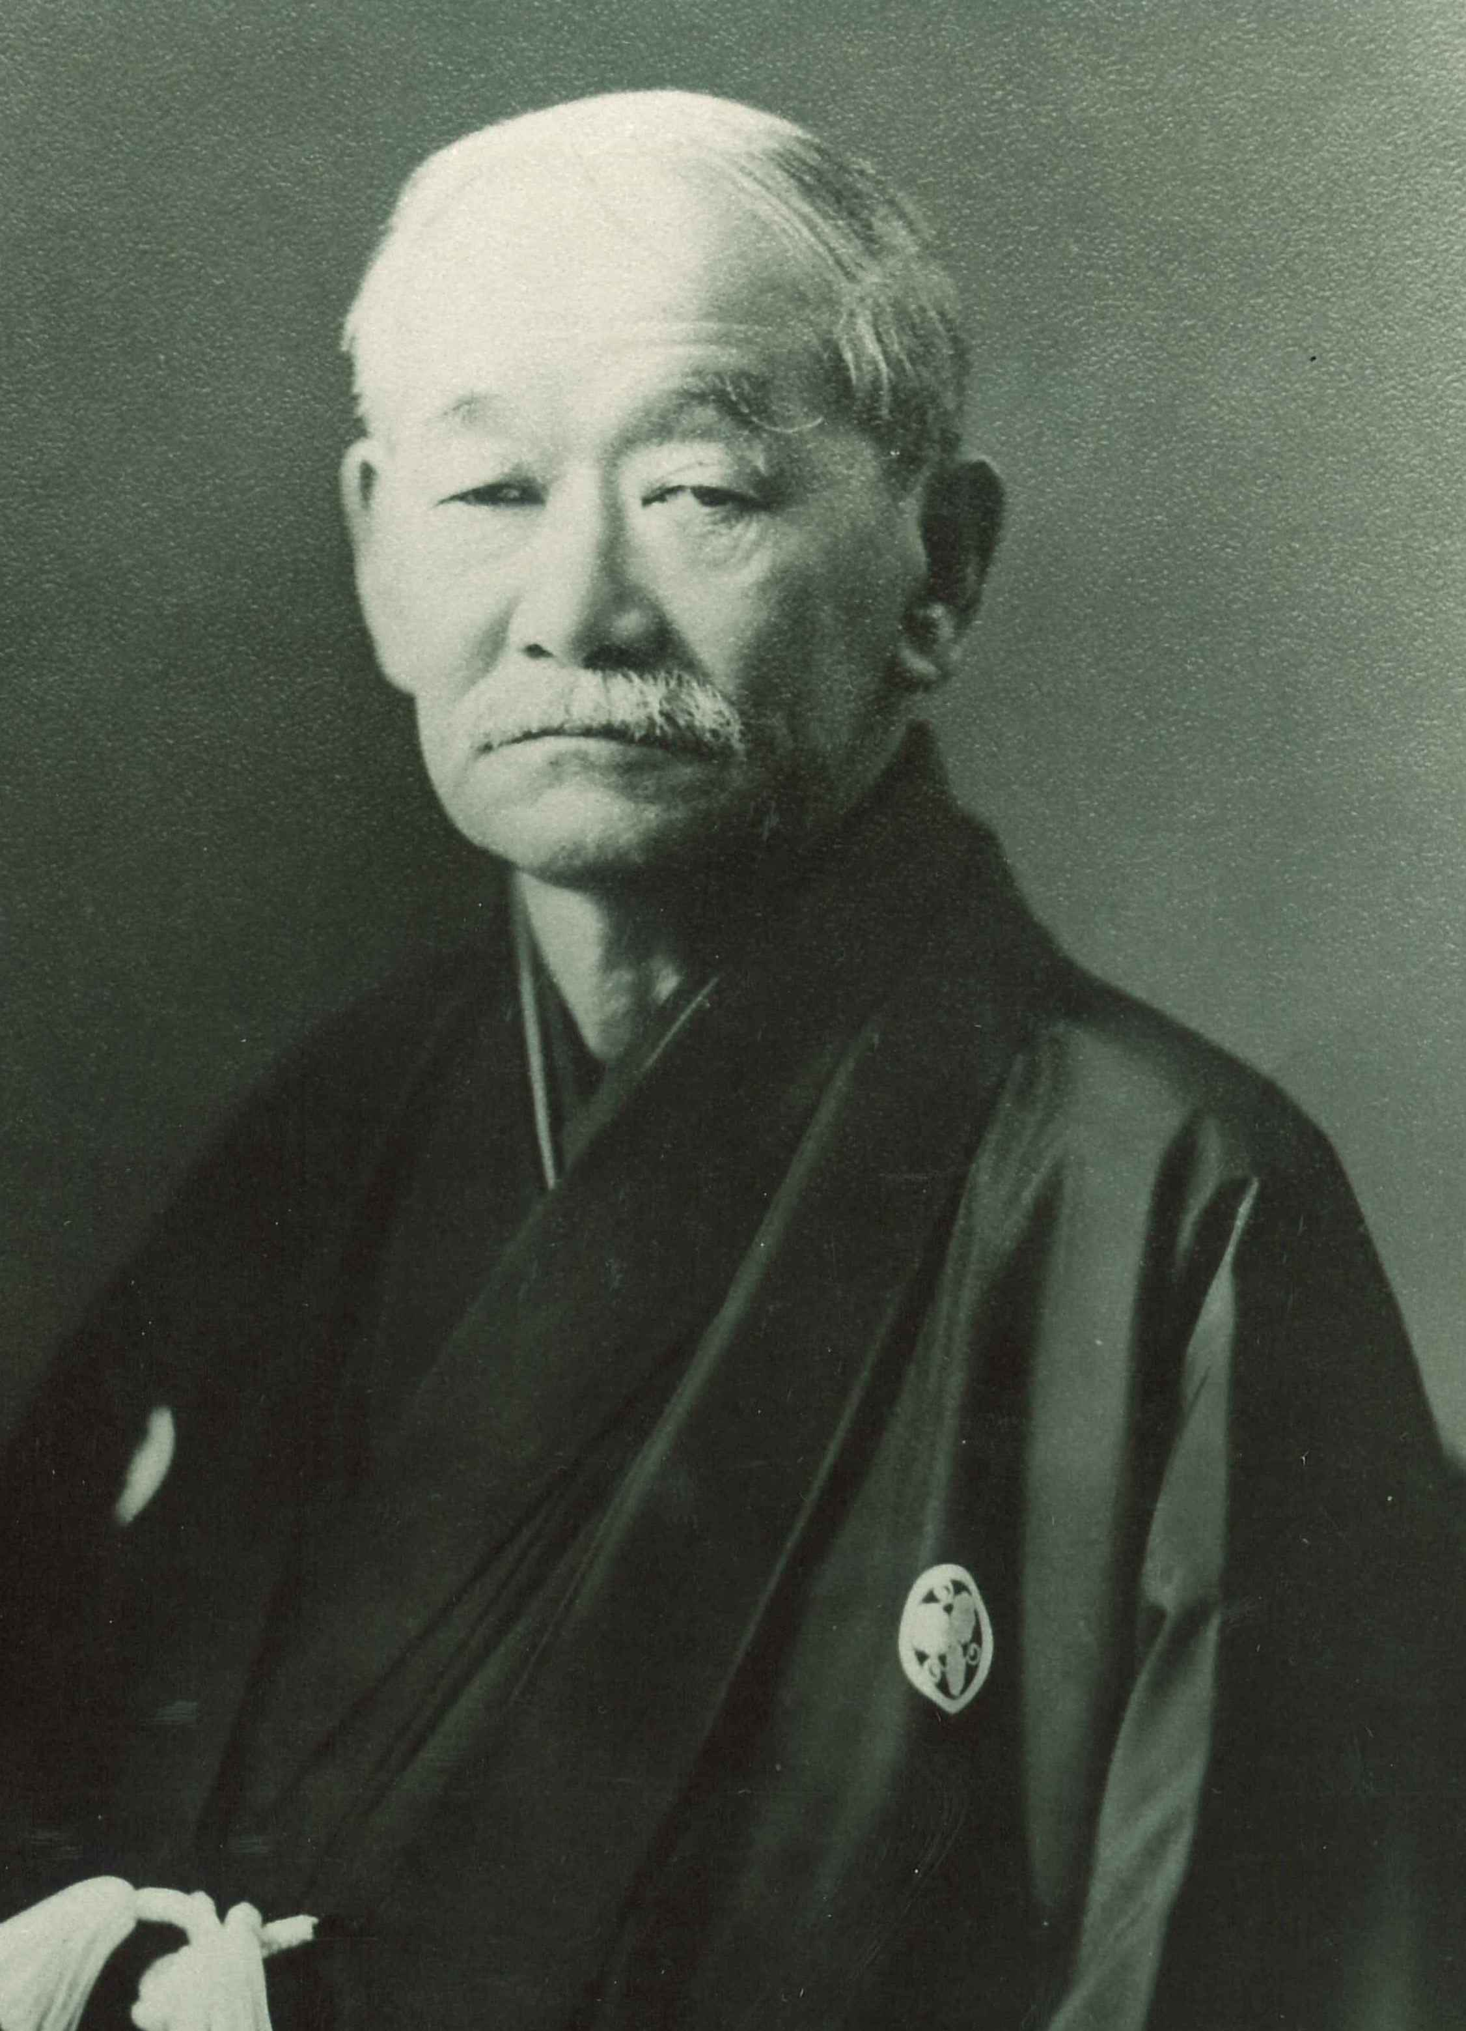
PRESIDENT: JIGORO KANO
1917 Tokyo (Japan)
3rd Far Eastern Championship Games

Slide 6
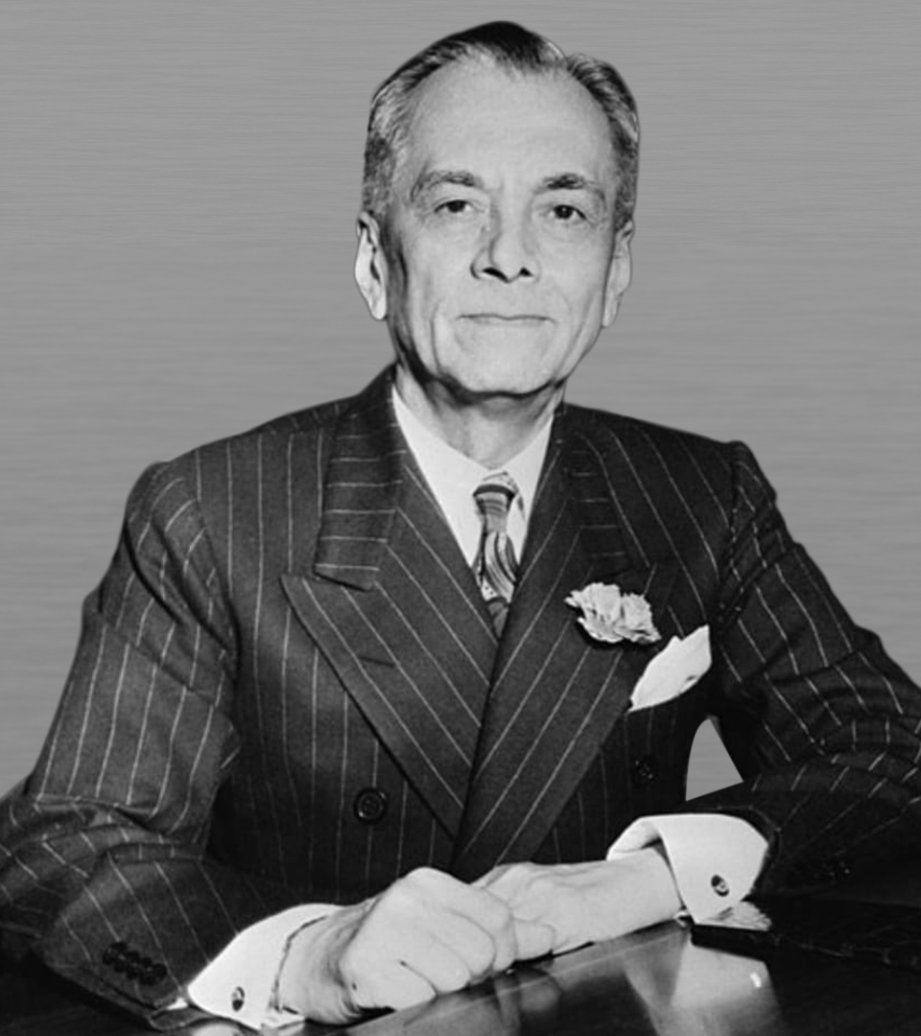
PRESIDENT: MANUEL L. QUEZON
1919 Manila (Philippines)
4th Far Eastern Championship Games
1925 Manila (Philippines)
7th Far Eastern Championship Games

Slide 7
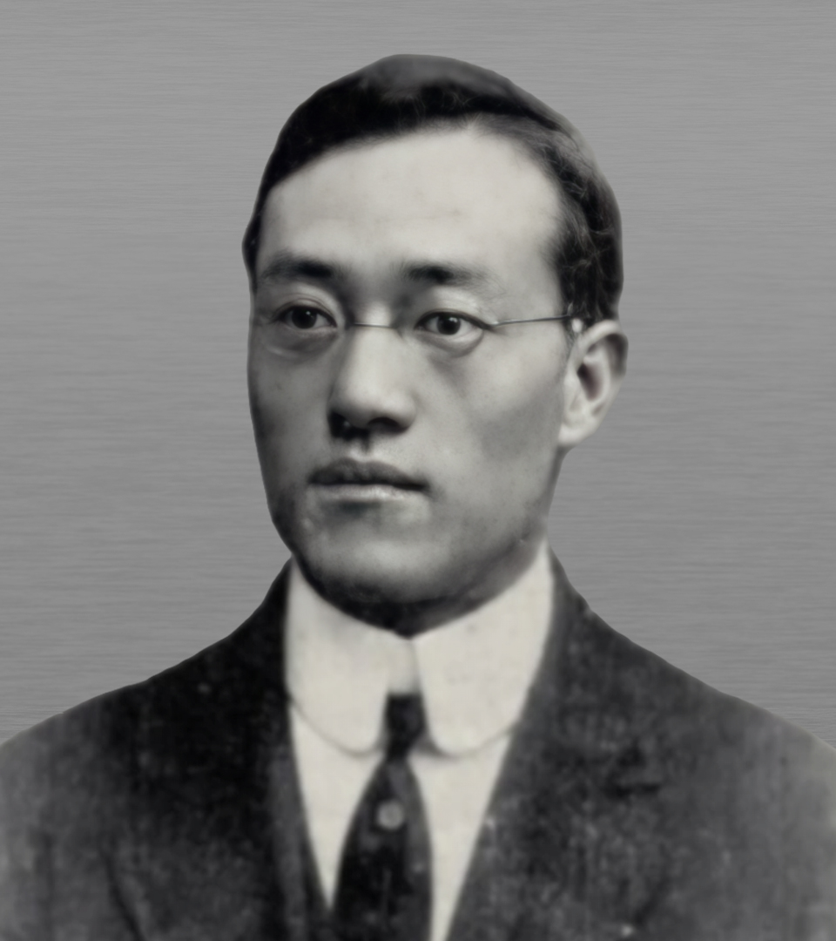
PRESIDENT: DR. C.T. WANG
1921 Shanghai (People’s Republic of China)
5th Far Eastern Championship Games

Slide 8
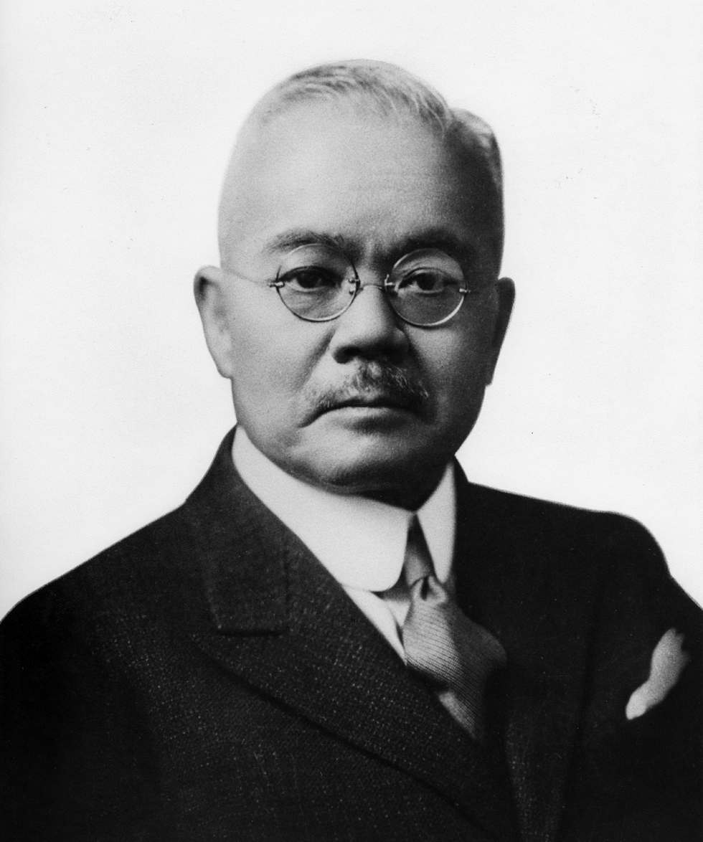
PRESIDENT: MR. SEIICHI KISHI
1923 Osaka (Japan)
6th Far Eastern Championship Games
1930 Tokyo (Japan)
8th Far Eastern Championship Games

Slide 9
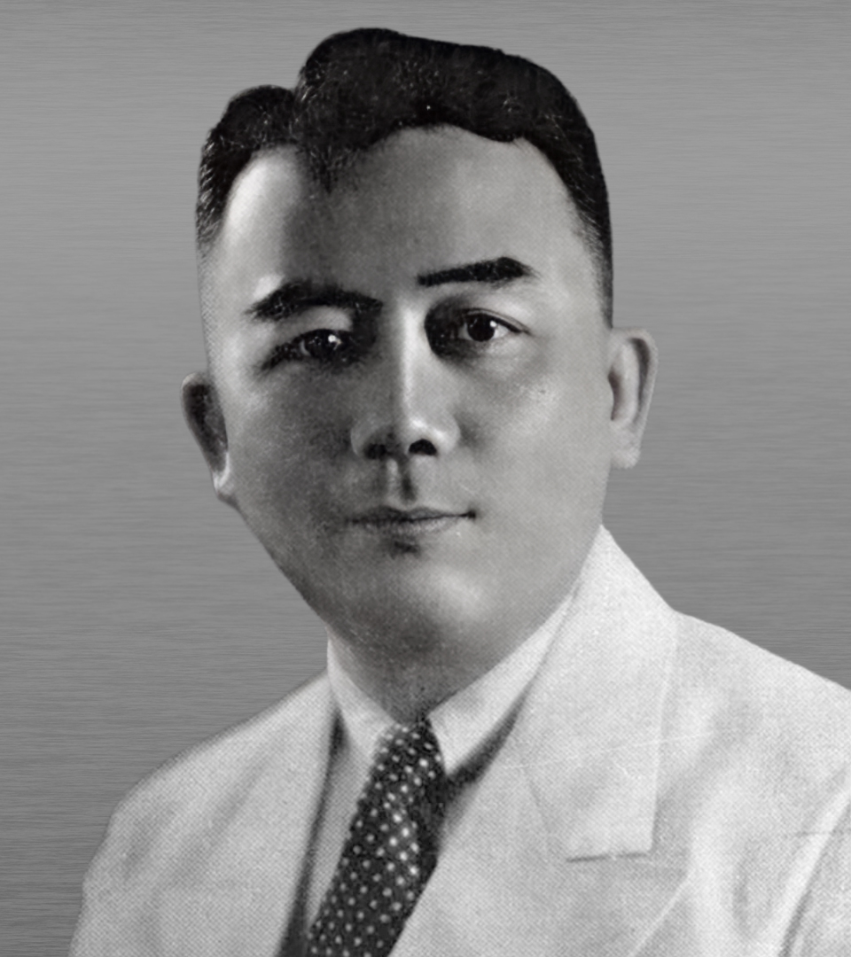
PRESIDENT: JORGE B. VARGAS
1934 Manila (Philippines)
9th Far Eastern Championship Games

Slide 10
ASIAN GAMES HISTORY
FIRST WEST ASIAN GAMES
(1934-1938)

Slide 11

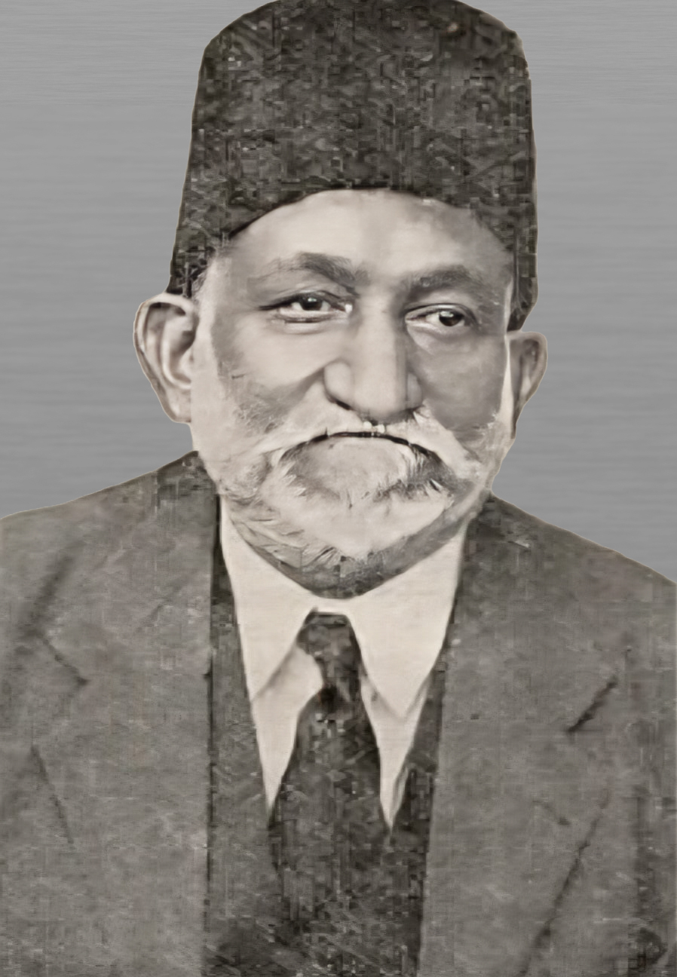
PRESIDENT: SIR AKBAR HYDARI
1934 New Delhi (India) First West Asian Games

Slide 12


The Asian Games Federation (AGF) united East & West Asia under one Organization in 1949 to organize the Asian Games every 4 years.

Slide 13
ASIAN GAMES HISTORY
ASIAN GAMES

Slide 14
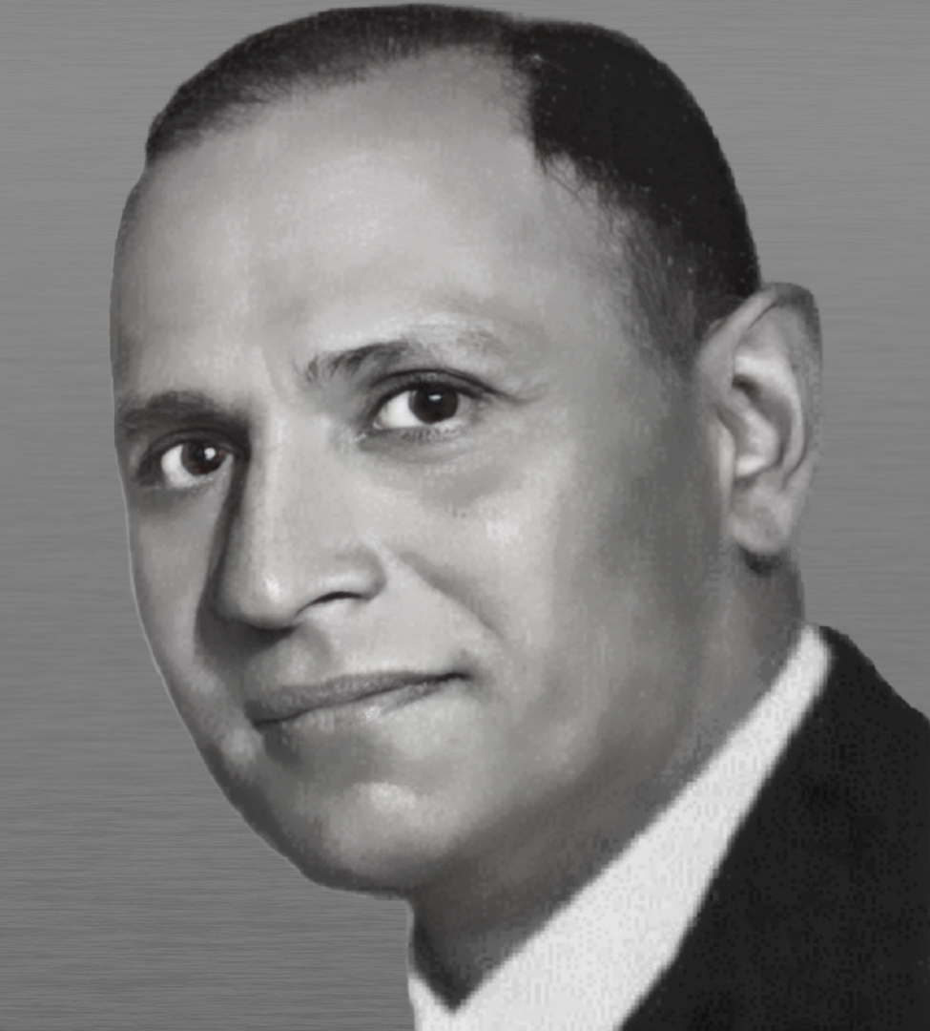
ASIAN GAMES FEDERATION
PRESIDENT: GURUDUTT SONDHI
1948 to 1960
1951- 1st Asian Games, New Delhi (India)
1954- 2nd Asian Games, Manila (Philippines)
1958- 3rd Asian Games, Tokyo (Japan)

Slide 15
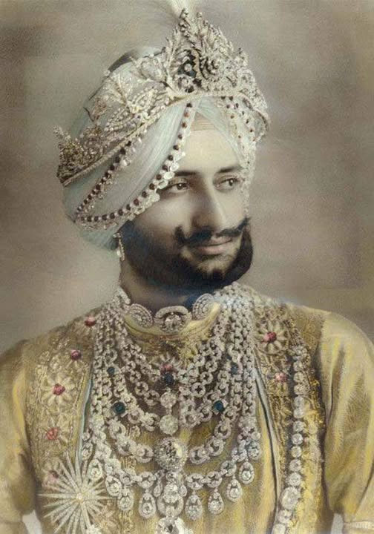
ASIAN GAMES FEDERATION
PRESIDENT: HRH MAHARAJA YADVENDRA SINGH
1960 - 1970
1962- 4th Asian Games, Jakarta (Indonesia).
1966- 5th Asian Games, Bangkok (Thailand)
1970- 6th Asian Games, Bangkok (Thailand)

Slide 16
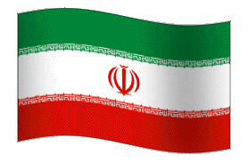
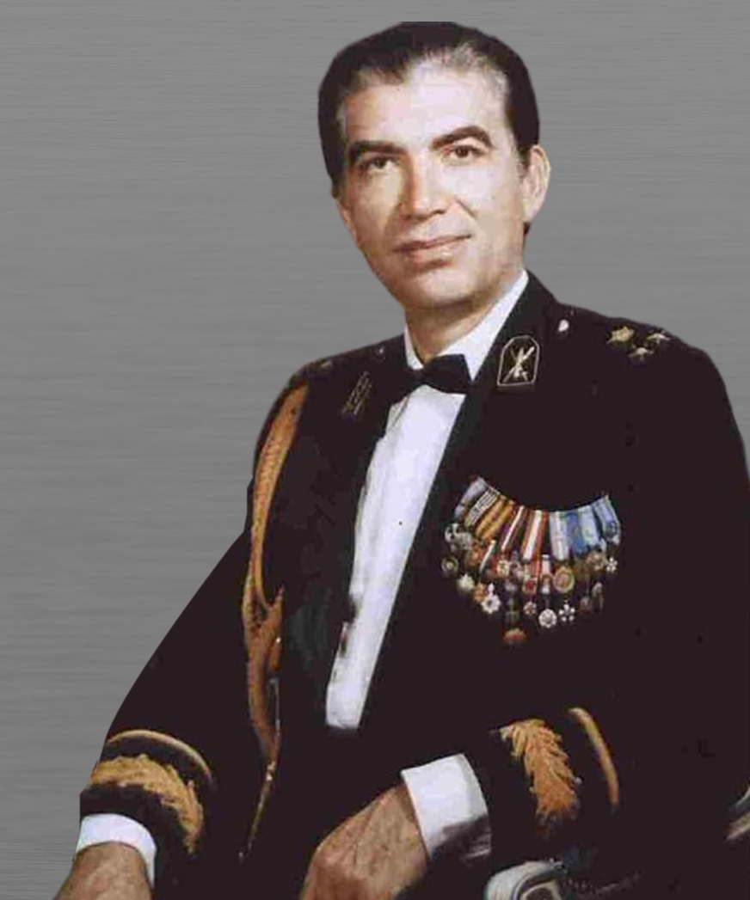
ASIAN GAMES FEDERATION
PRESIDENT: HRH PRINCE GHOLAMREZA PEHALVI
1970 - 1974
1974- 7th Asian Games, Tehran (Iran)

Slide 17

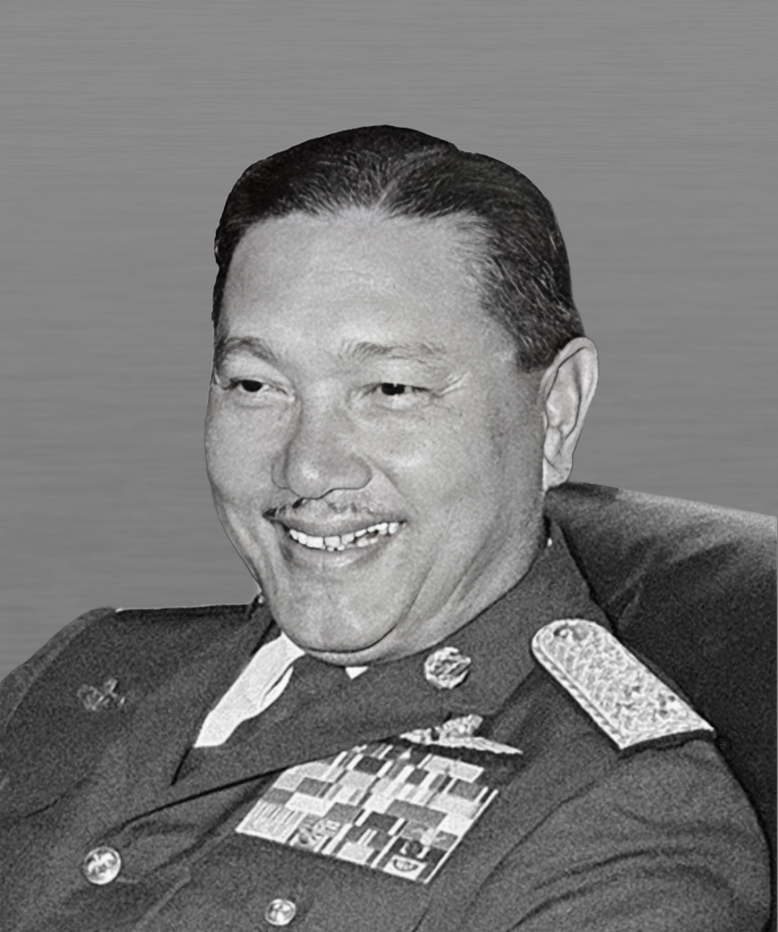
ASIAN GAMES FEDERATION
PRESIDENT: AIR CHIEF MARSHAL DAWEE CHULLASAPYA
1974 - 1978
1978- 8th Asian Games, Bangkok (Thailand)

Slide 18
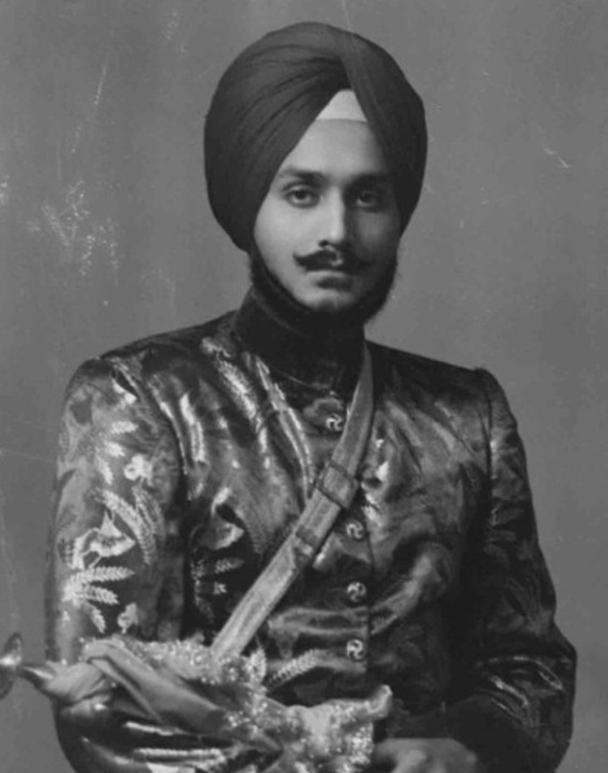
ASIAN GAMES FEDERATION
PRESIDENT: RAJA BHALENDRA SINGH
1978 - 1982
1982- 9th Asian Games, New Delhi (India)

Slide 19

In 1981 - The Sports leaders in Asia decided to change the name from Asian Games Federation (AGF) to Olympic Council of Asia (OCA)

Slide 20

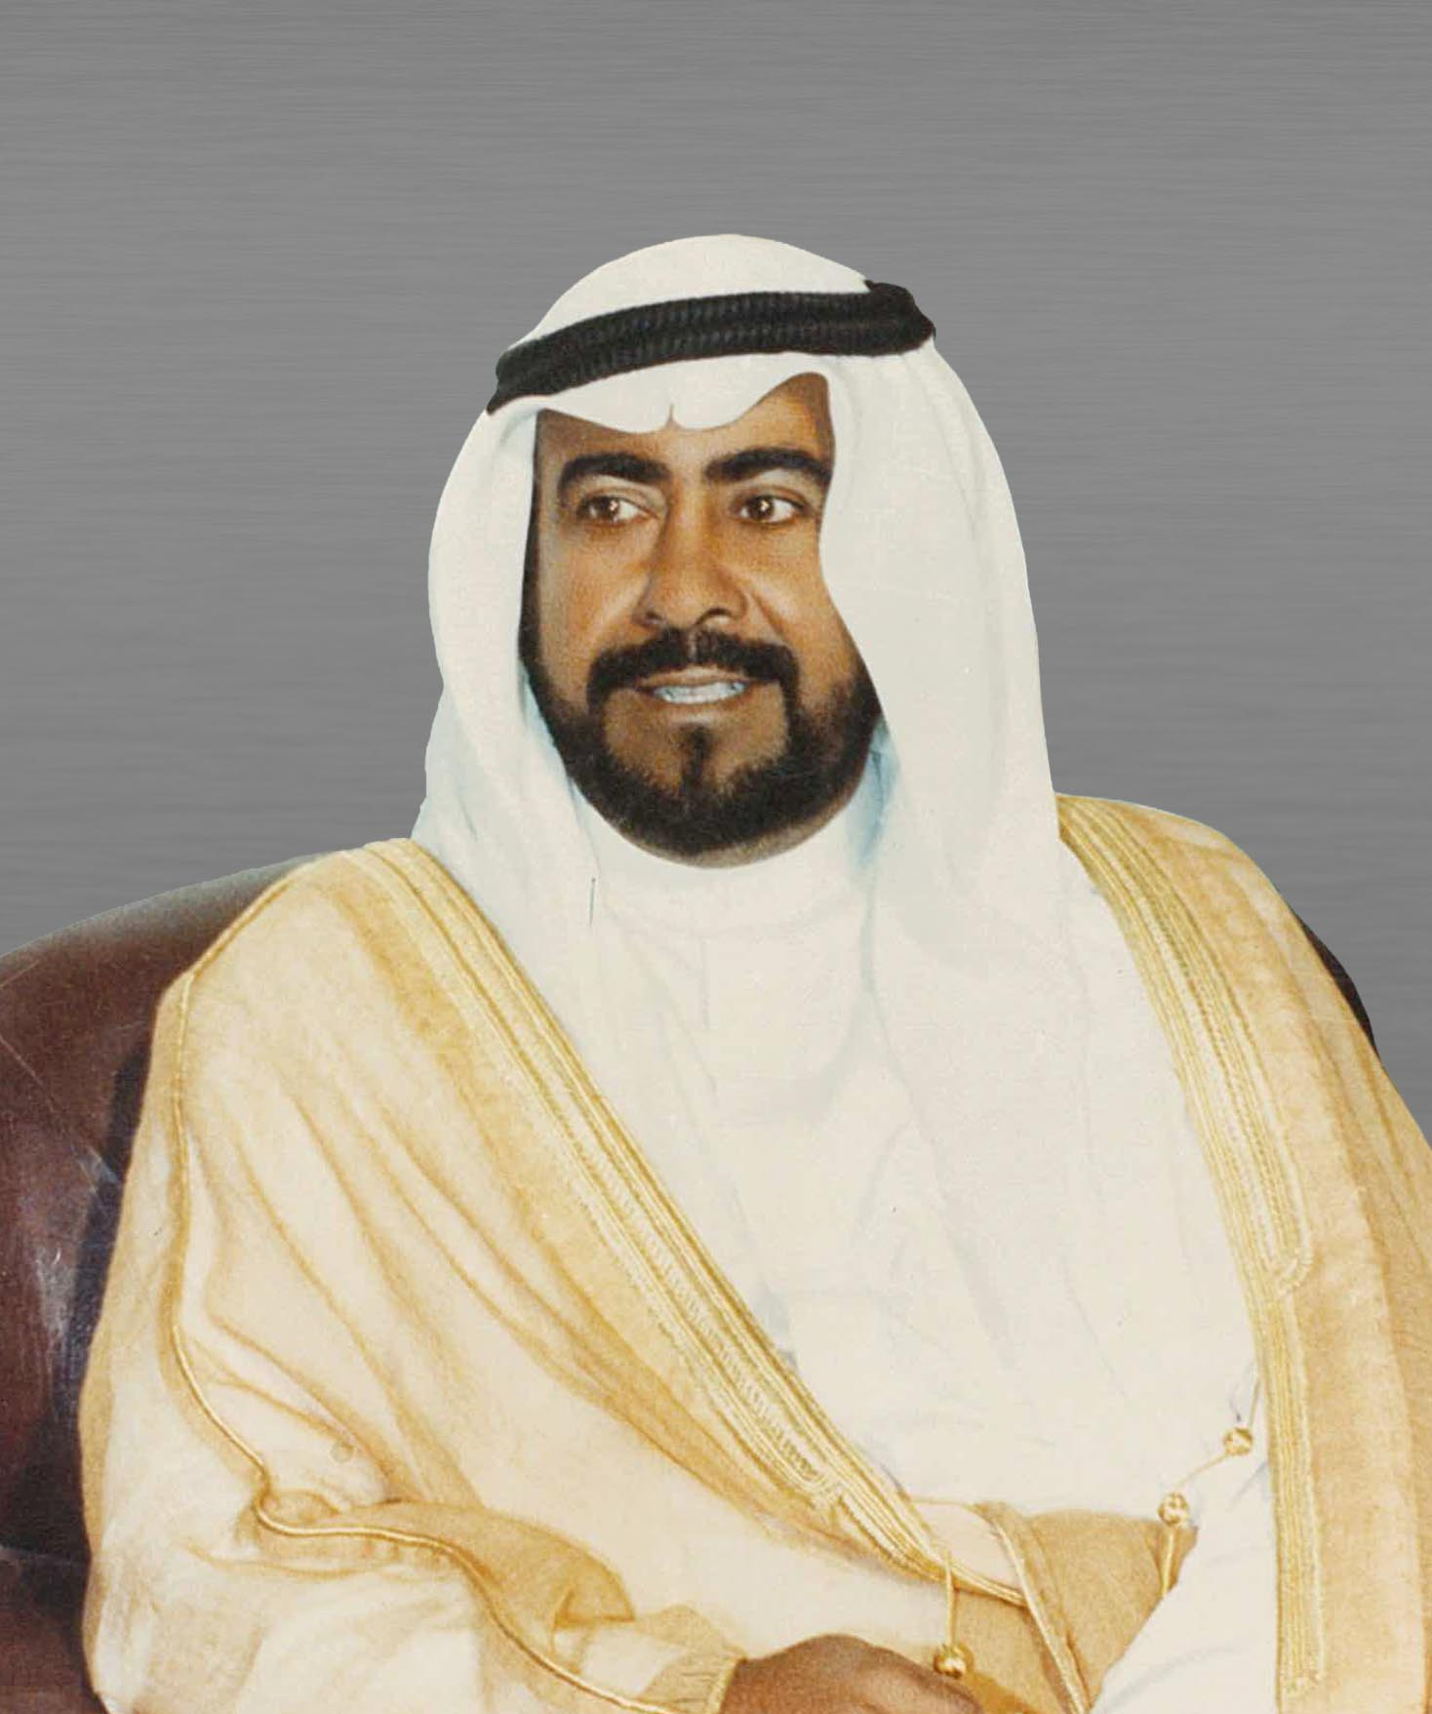
PRESIDENT - OLYMPIC COUNCIL OF ASIA
PRESIDENT: HE SHEIKH FAHAD AL AHMAD AL SABAH
1982 - 1990
1986- 10th Asian Games, Seoul (Korea)

Slide 21

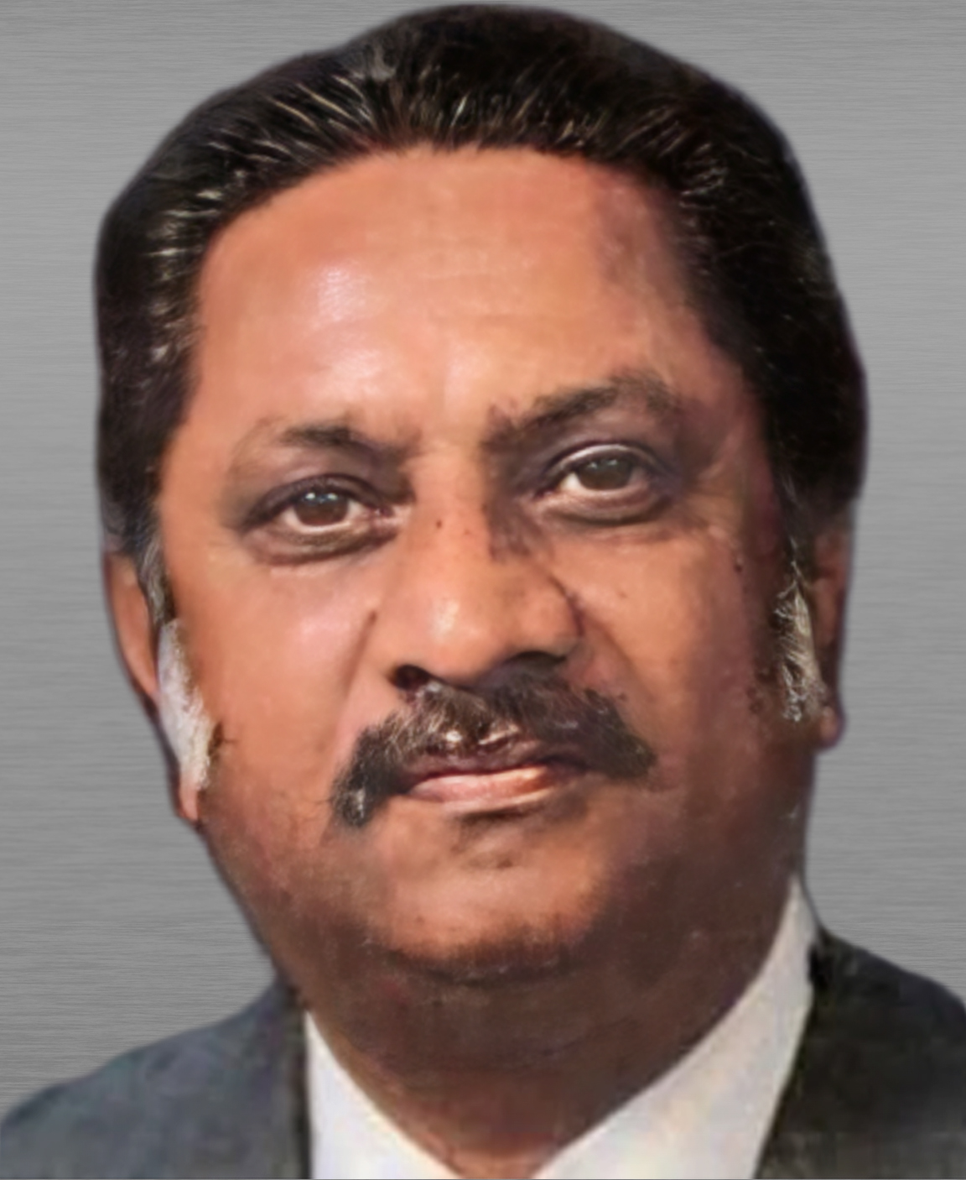
ACTING PRESIDENT - OLYMPIC COUNCIL OF ASIA
MR ROY DE SILVA
1990 - 1991
1990- 11th Asian Games, Beijing (People’s Republic of China)

Slide 22
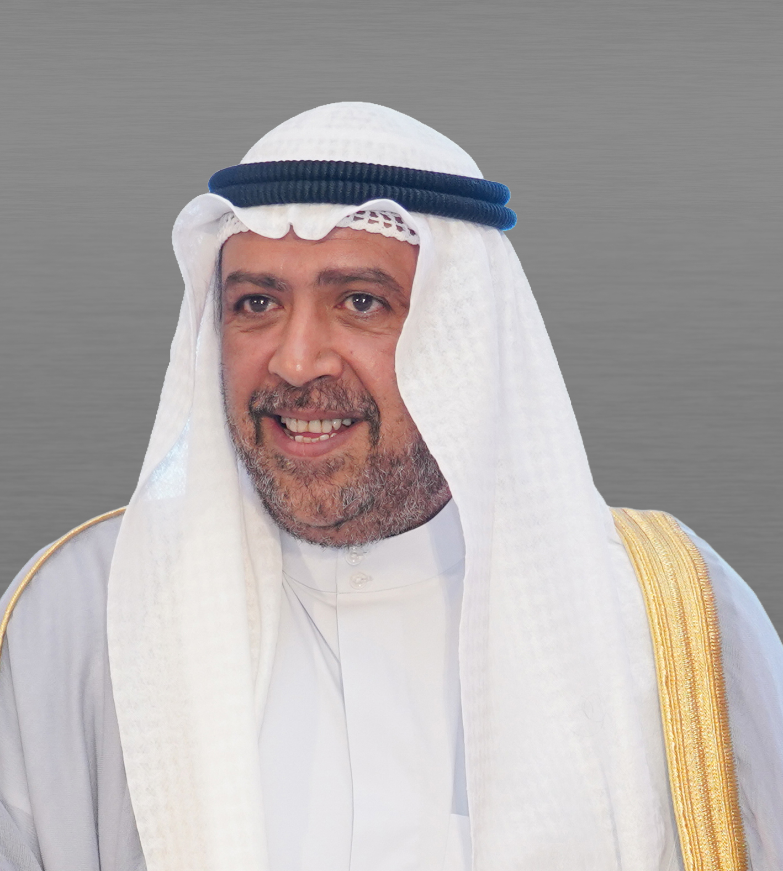
PRESIDENT - OLYMPIC COUNCIL OF ASIA
PRESIDENT: HE SHEIKH AHMAD AL FAHAD AL SABAH
1991 - 2021
1994- 12th Asian Games , Hiroshima (Japan).
1998- 13th Asian Games, Bangkok (Thailand)
2002- 14th Asian Games, Busan (Korea)
2006- 15th Asian Games, Doha (Qatar)
2010- 16th Asian Games, Guangzhou (People’s Republic of China)
2014- 17th Asian Games, Incheon (Korea)
2018- 18th Asian Games, Jakarta-Palembang (Indonesia)

Slide 23
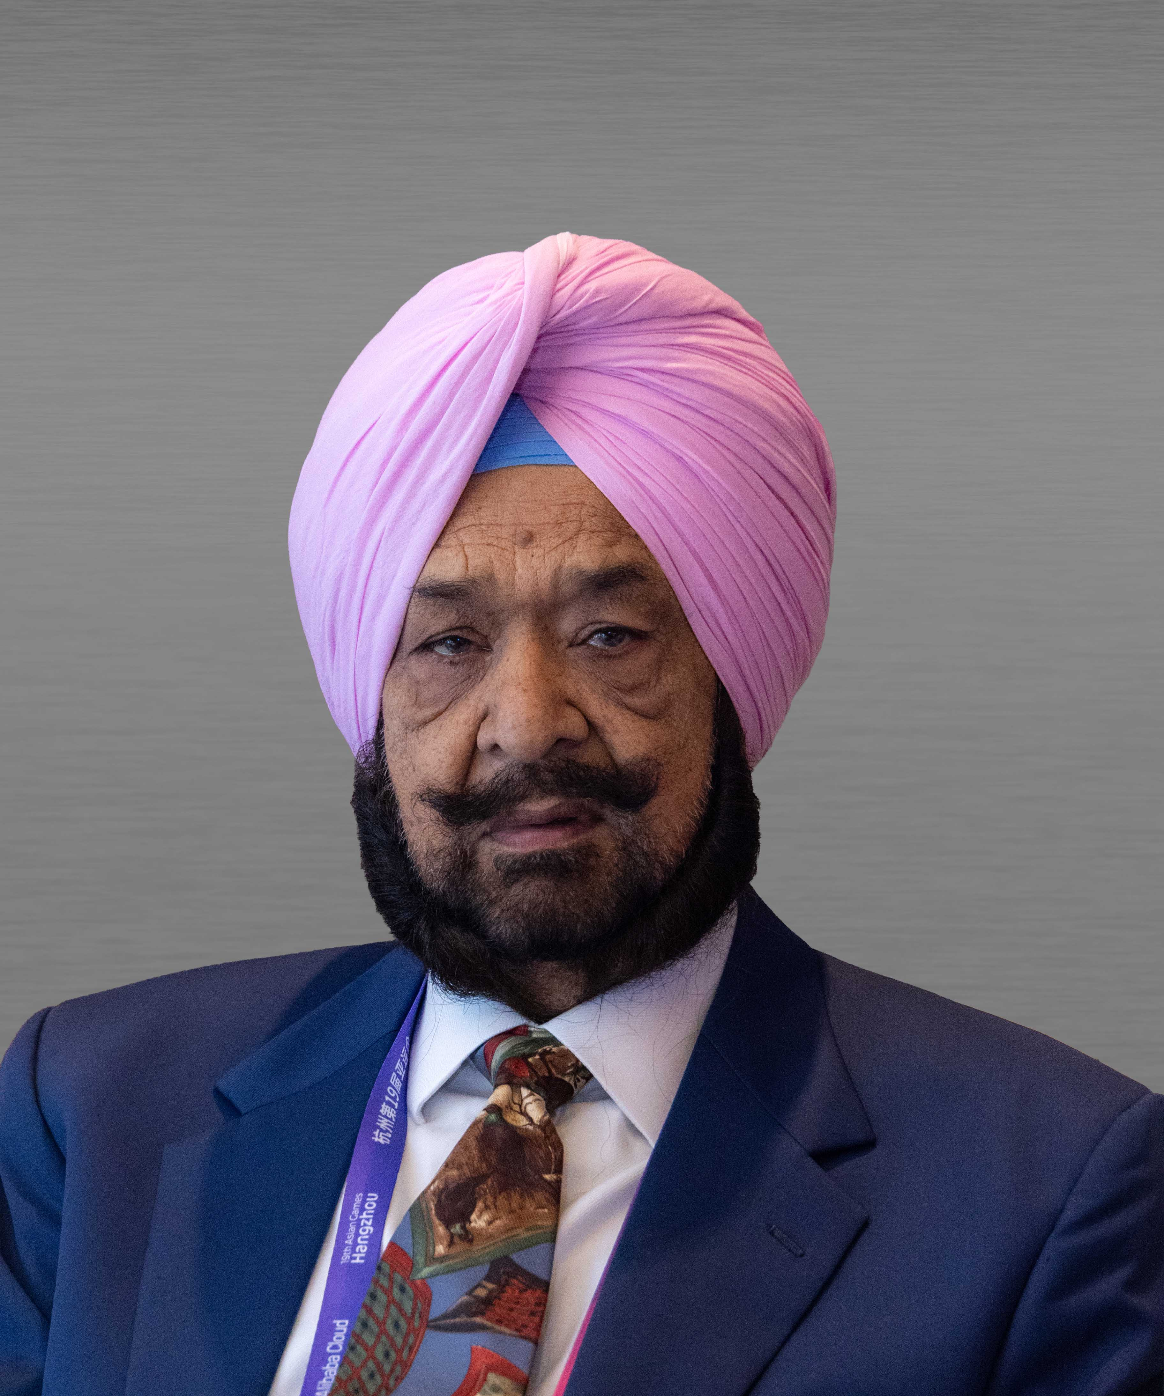
PRESIDENT - OLYMPIC COUNCIL OF ASIA
ACTING PRESIDENT : RAJA RANDHIR SINGH
2021 - 2024
PRESIDENT : RAJA RANDHIR SINGH
2024 – 2025
2022 – 19th Asian Games, Hangzhou (People’s Republic of China).

Slide 24

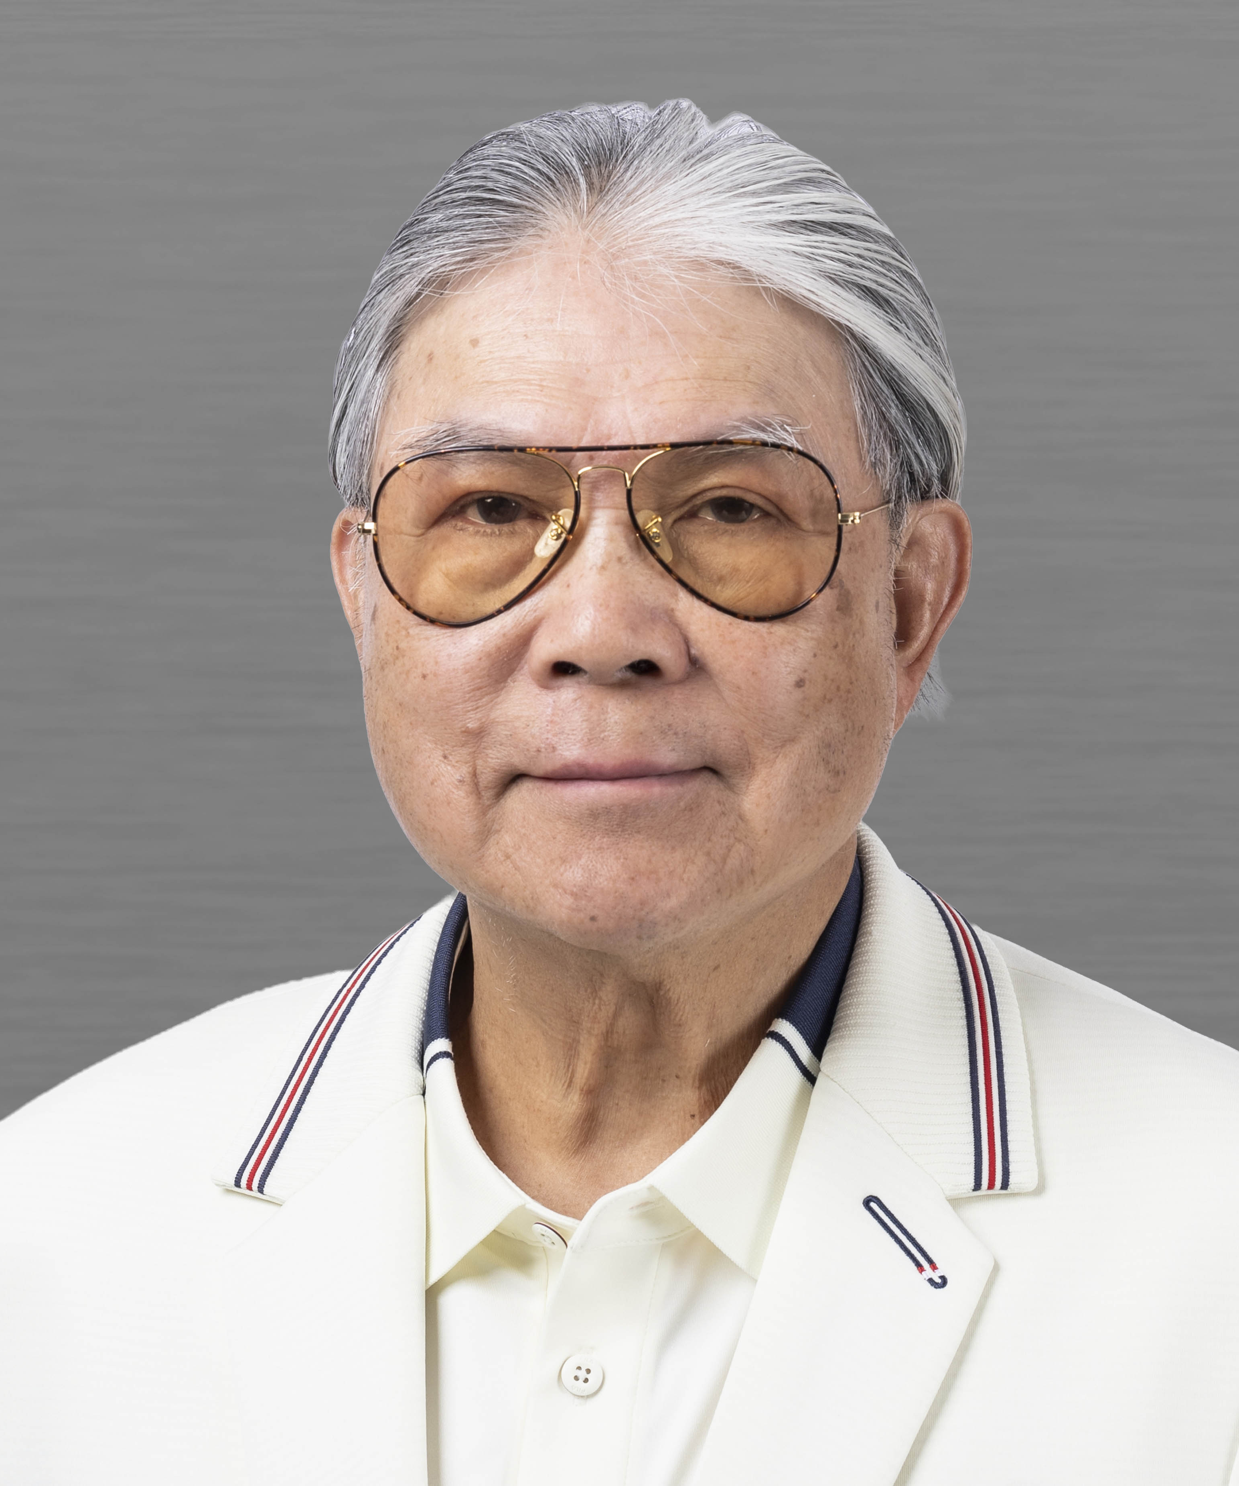
ACTING PRESIDENT- OLYMPIC COUNCIL OF ASIA
MR TIMOTHY FOK
2025 - 2026

Slide 25

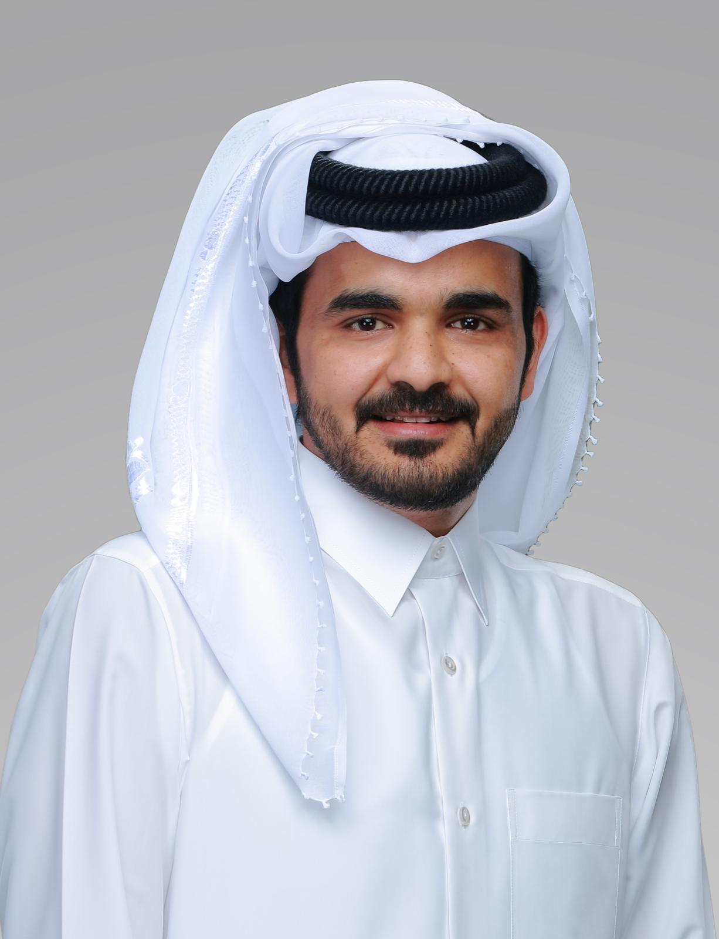
PRESIDENT - OLYMPIC COUNCIL OF ASIA
PRESIDENT : H.E. SHEIKH JOAAN BIN HAMAD AL-THANI
2026
2026- 20th Asian Games Aichi-Nagoya(Japan)

